Slide 1

Welcome to our presentation

Slide 2
Team Members
Tamanna Akter (221-15-5298)
Arif Billah (221-15-5842)
Abdullah Al Rifat (221-15-5954)
Binota Ray (221-15-5337)

Slide 3

Platform Name:
TherapyKaro
Bangladesh
"Instant Access to Expert Therapists—Anytime, Anywhere."
TherapyKaro is the is the online mental health online platform to provide online counciling and therapy session .

Slide 4

Background:​
1. To offer flexible and accessible mental health services through the internet.
2. To utilizes of communication methods( video calls, live chats, messaging)
3. To provide detailed therapist profiles .
4. To help users select the best match for their specific needs.
5. TherapyKaro aims to reduce barriers to effective mental health care
7. Making it easier for individuals to receive timely and personalized support from the comfort of their own homes.

Slide 5

Objectives
Enhance Accessibility
Diverse Therapeutic Options
User Privacy and Security
Flexible Scheduling and Communication
Affordable Mental Health Care
Continuous Improvement and Feedback

Slide 6
System Requirements
Operating System
Should support Windows 10 and above, macOS 10.13 (High Sierra) and above, and modern Linux distributions for desktops and laptops.
Browser Compatibility
Fully compatible with the latest versions of major browsers including Google Chrome, Mozilla Firefox, Safari, and Microsoft Edge.
Internet Connection
Requires a reliable internet connection with a minimum bandwidth of 5 Mbps for video streaming and data transfer.
Processor
Minimum of a dual-core processor, but a quad-core processor or better is recommended for optimal performance.

Slide 7
System Requirements
RAM
At least 4 GB of RAM, with 8 GB recommended for better multitasking and smoother video conferencing.
Webcam and Microphone
HD webcam and a microphone with clear audio capture capabilities for communication.
Sound
Speakers or headphones for clear audio playback during sessions.
Mobile Device Support
Should support mobile devices with iOS 11.0 and Android 7.0 or newer.

Slide 8
System Requirements
Storage
At least 100 MB of free disk space for installation of application and temporary files.
Security
Up-to-date security software and SSL/TLS support for secure data transmission and user privacy protection.

Slide 9

Features/ Functionalities
User Profile
Therapist Matching
Appointment Scheduling
Video Conferencing
Secure Messaging
Payment Gateway
Session Notes and Tracking
Resource Library
Emergency Contact Features
Feedback System
Multi-Language Support
Privacy and Security Compliance

Slide 10
Security/Safety
Data Encryption
All data transmitted between clients and therapists, including video calls, messages, and stored session notes, should be encrypted using strong encryption protocols such as TLS/SSL. This ensures that sensitive information is secure from unauthorized access during transmission.
Compliance with Regulations
Adherence to relevant health data protection regulations, such as HIPAA in the United States, GDPR in Europe, or similar standards globally, which govern the handling and privacy of patient information.
Secure Authentication
Implementation of strong authentication methods, such as two-factor authentication (2FA), to verify the identity of both therapists and clients. This reduces the risk of unauthorized access to accounts.

Slide 11
Security/Safety
Privacy Controls
Clients should have control over their privacy settings, including the ability to control who can see their profiles and personal information, and the ability to delete their data permanently.
Secure Payment Processing
Integration of secure payment gateways that comply with PCI DSS standards to protect financial data used during transactions.
Regular Security Audits
Conducting regular security audits and vulnerability assessments to identify and rectify potential security issues.

Slide 12
Security/Safety
Emergency Protocols
Systems should be in place for clients to quickly access emergency support if a crisis occurs during a session, including clear guidelines on how therapists should respond in such situations.
Anonymity Options
For additional privacy, platforms may offer features that allow clients to remain anonymous during sessions if they prefer.

Slide 13
Data Management
Structured Data Collection: Collect only essential user data such as demographics, session details, and health information, ensuring efficiency and compliance with privacy laws.
Secure Data Storage: Utilize encrypted storage solutions to safeguard sensitive user information, preventing unauthorized access.
Access Controls: Implement strict access controls, ensuring that only authorized personnel have access to specific types of data based on their roles.
Data Encryption: Encrypt data in transit and at rest using advanced encryption standards to protect data integrity and confidentiality.
Data Minimization: Adhere to the principle of data minimization, ensuring that no unnecessary personal data is stored.
Regular Audits: Conduct regular audits of data practices to ensure compliance with internal policies and external regulations.

Slide 14
Data Management
Backup and Disaster Recovery: Establish robust backup procedures and disaster recovery plans to ensure data can be restored quickly after any data loss incident.
Compliance with Privacy Laws: Comply with relevant data protection regulations such as GDPR or HIPAA, incorporating necessary controls to protect user privacy.
Anonymization Techniques: Use data anonymization techniques when processing data for analytics to prevent identification of individual users.
Data Retention and Deletion Policies: Clearly define data retention periods and deletion procedures to ensure data is not kept longer than necessary and is securely deleted when no longer needed.

Slide 15
System Design
Multi-tier Architecture: Incorporates a scalable multi-tier architecture that separates the presentation, application, and data management layers to enhance manageability and scalability.
Responsive Web Design: Utilizes responsive design principles to ensure the platform is accessible and user-friendly across various devices and screen sizes.
Secure Authentication: Implements OAuth2 and JWT for secure user authentication, ensuring that user sessions are managed safely and effectively.
Microservices Approach: Adopts a microservices architecture to modularize functionalities, improving fault isolation and enabling independent scaling of different components.
API Gateway: Uses an API gateway to manage, authenticate, and route API calls between clients and services, providing a single entry point for all backend services.

Slide 16
System Design
Data Encryption: Employs end-to-end encryption for data in transit and at rest, protecting sensitive user information and compliance with data protection regulations.
Load Balancing: Integrates load balancers to distribute incoming network traffic across multiple servers, ensuring reliability and high availability.
Cloud-Based Infrastructure: Leverages cloud infrastructure for hosting, which provides flexibility, scalability, and disaster recovery solutions.
Continuous Integration/Continuous Deployment (CI/CD): Implements CI/CD pipelines for automated testing and deployment, facilitating rapid and reliable code updates.
Real-Time Data Processing: Utilizes real-time data processing for live video sessions and instant messaging, ensuring minimal latency and a smooth user experience.

Slide 17
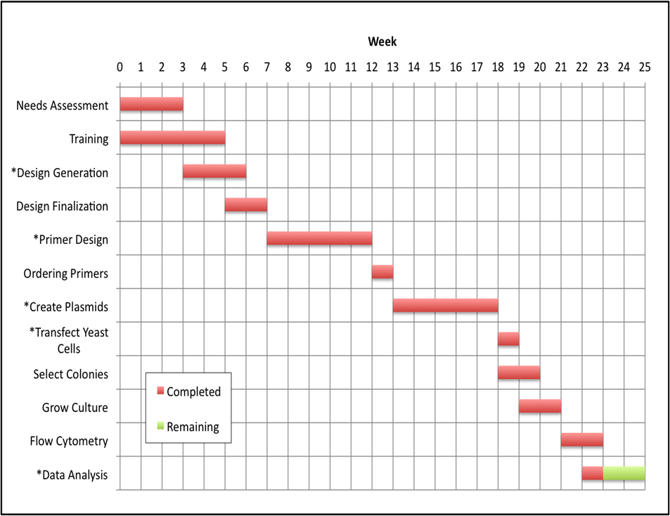
Time management using Gantt chart:

Slide 18

Implementation
Agile Methodology
Secure Coding
Usability Focus
Tech Stack Selection
Continuous Integration/Continuous Deployment (CI/CD)
Quality Assurance
Data Privacy Compliance
Feedback Mechanism
Scalability Planning
Post-Launch Support

Slide 19

Unit Testing
Integration Testing
System Testing
Security Testing
Performance Testing
Usability Testing
Compatibility Testing
Regression Testing
User Acceptance Testing (UAT)
Post-Deployment Testing
Testing

Slide 20
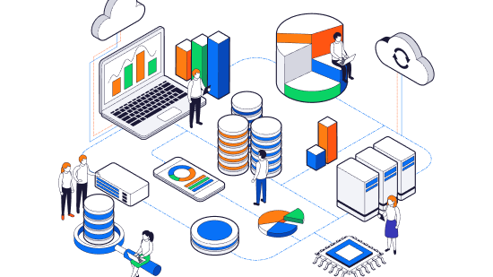
Pre-Launch Checks
Phased Rollout
Cloud Hosting
Performance Monitoring
Real-Time Monitoring
Secure Cloud Hosting
Incremental Updates
User Support and Training
Version Control
Environment Setup
Feedback Loop
Testing
Deployment Staging Environment

Slide 21

Routine Updates
System Monitoring
Data Backup
User Feedback
Performance Optimization
Compliance Checks
Maintenance

Slide 22

Conclusion
In conclusion, TherapyKero offers a robust and secure platform for online counseling, providing essential mental health services with ease and flexibility. Its user-friendly interface and professional support ensure that help is just a few clicks away, catering to individuals seeking guidance in a confidential environment. This platform bridges the gap between mental health professionals and those in need, making psychological support more accessible and effective than ever.

Slide 23


